Slide 1
Learning from Patients to Provide Accessible Healthcare and Effective Communication for Patients who are Blind or have Low Vision

Slide 2
Presenters
Melanie Peskoe, MPH
Carlie Rhoads, PhD
Arielle Silverman, PhD
American Foundation for the Blind Public Policy and Research Institute

Slide 3
Patient Stories
“…they just asked my dad for my name and birth date, which I gave quickly, spelling my name in case that was needed. They asked my dad if I was having a procedure at the hospital, and I again answered quickly. “
“Before leaving me to get ready for the procedure, the assistant asked if I needed help getting undressed. I felt so belittled.”

Slide 4
About AFB
The American Foundation for the Blind is a national nonprofit working to create a world of no limits for people who are blind or visually impaired.
We mobilize leaders, advance understanding, and champion impactful policies and practices using research and data.
Public Policy and Research Institute
Produces research to understand the experiences of people who are blind or have low vision
Advocates for federal policies that create opportunities
Publishes the Journal of Visual Impairment & Blindness

Slide 5
About people who are blind or have low vision
According to the American Community Survey (2019), approximately 7.5 million non-institutionalized people report having a vision related disability.

Slide 6
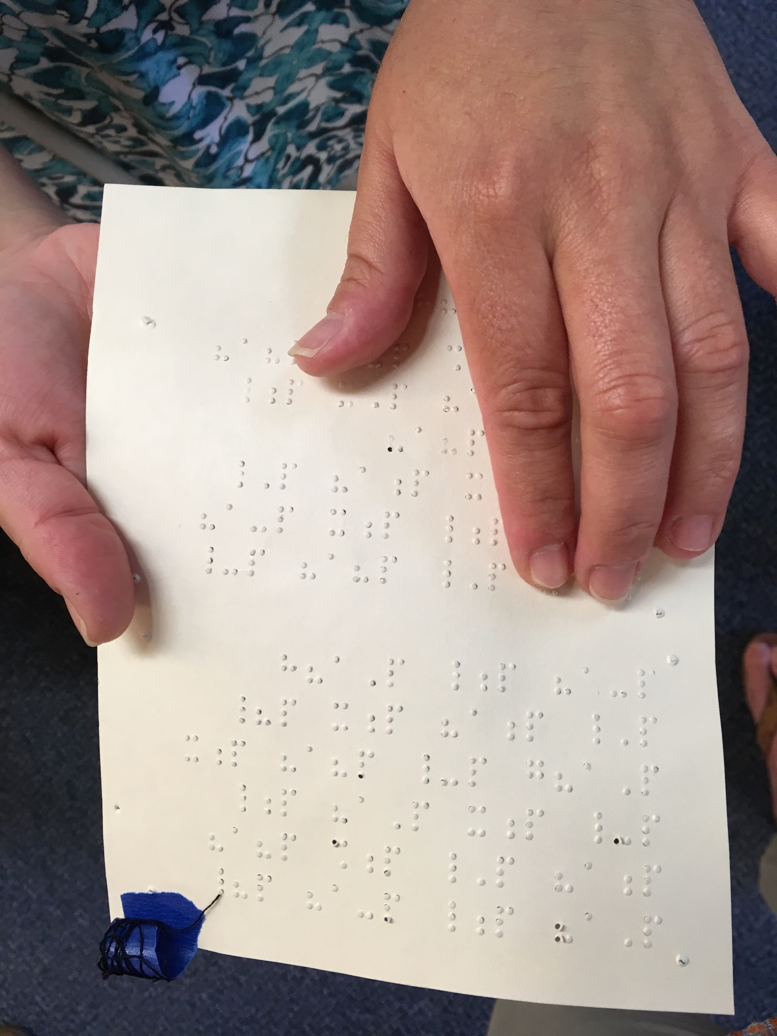
Some Impacts of Blindness and Low Vision on Daily Living
Most people have a preference about how they read:
large print or braille
electronic device to access text
listening to text via a reader or audio recording.

Slide 7
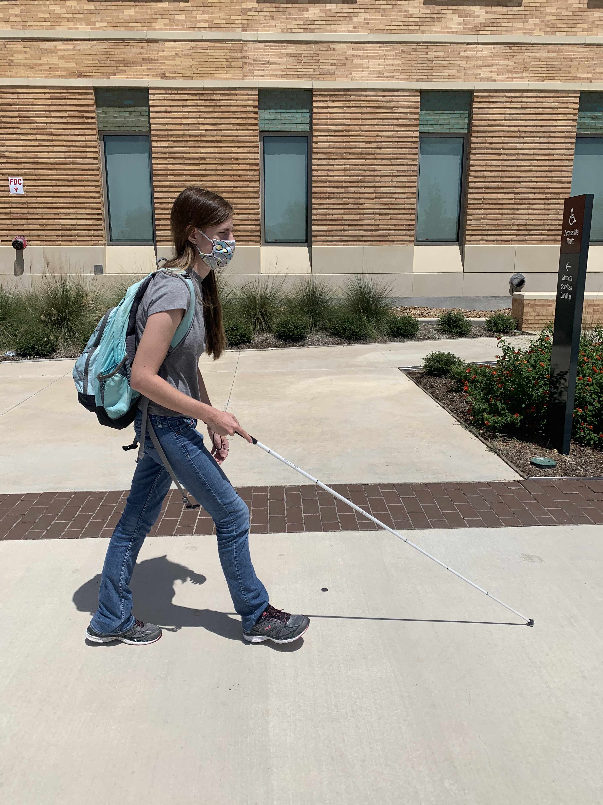
Impacts (cont.)
Some people use a long white cane, a guide dog, or neither.

Slide 8
What does the Americans with Disabilities Act cover?
Together, the ADA, Section 504 of the Rehabilitation Act, and Section 1557 of the Affordable Care Act (ACA) prohibit discrimination on the basis of disability in health care facilities, programs, and activities
The ADA applies to employers, public entities, and public accommodations

Slide 9
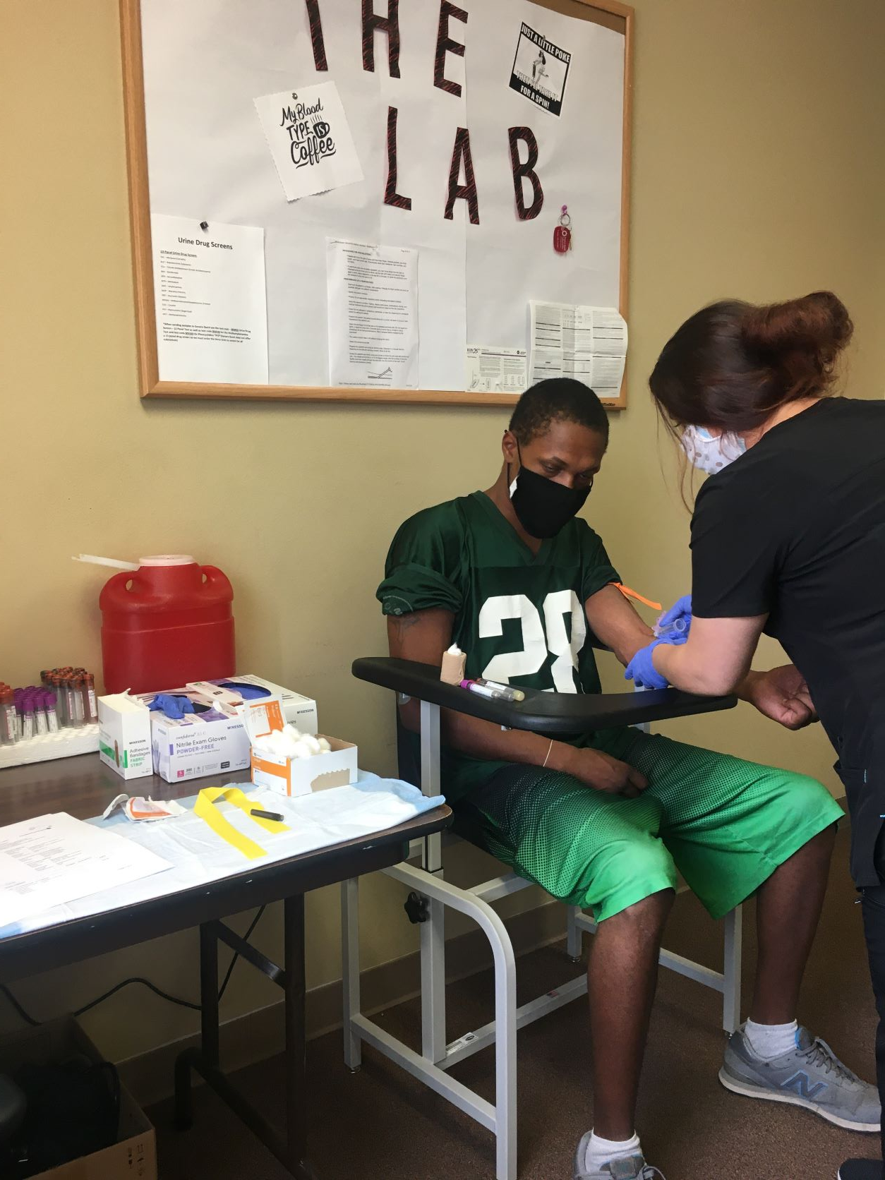
ADA (cont.)
Healthcare providers are required to ensure that:
Facilities and equipment are accessible
Providers engage in effective communication with people with disabilities
Policies, programs, and procedures are modified when necessary to prevent discrimination

Slide 10
Our Research
Hospital project
Literature Review and Focus Groups
Conducted two focus groups with individuals who are blind or have low vision in Huntington, West Virginia.
Participants tended to be older, white, college educated, and to have had limited incomes at the time of the study.

Slide 11
Our Research
Topics included:
How would you define healthcare quality?
Communication with medical and non-medical staff
Access to hospital services
Getting to and around the hospital
Training doctors and hospital staff
Designing hospital procedures for people who are blind or visually impaired

Slide 12
Flatten Inaccessibility
Survey conducted in April 2020 exploring the experiences of people who are blind or have low vision during the COVID-19 pandemic.
1,921 Respondents, of whom 1,010 answered questions about healthcare.
While this research did not specifically examine ADA standards, it did explore the impact on patients of having accessible facilities, effective communication, and appropriate modifications to some policies and practices.

Slide 13
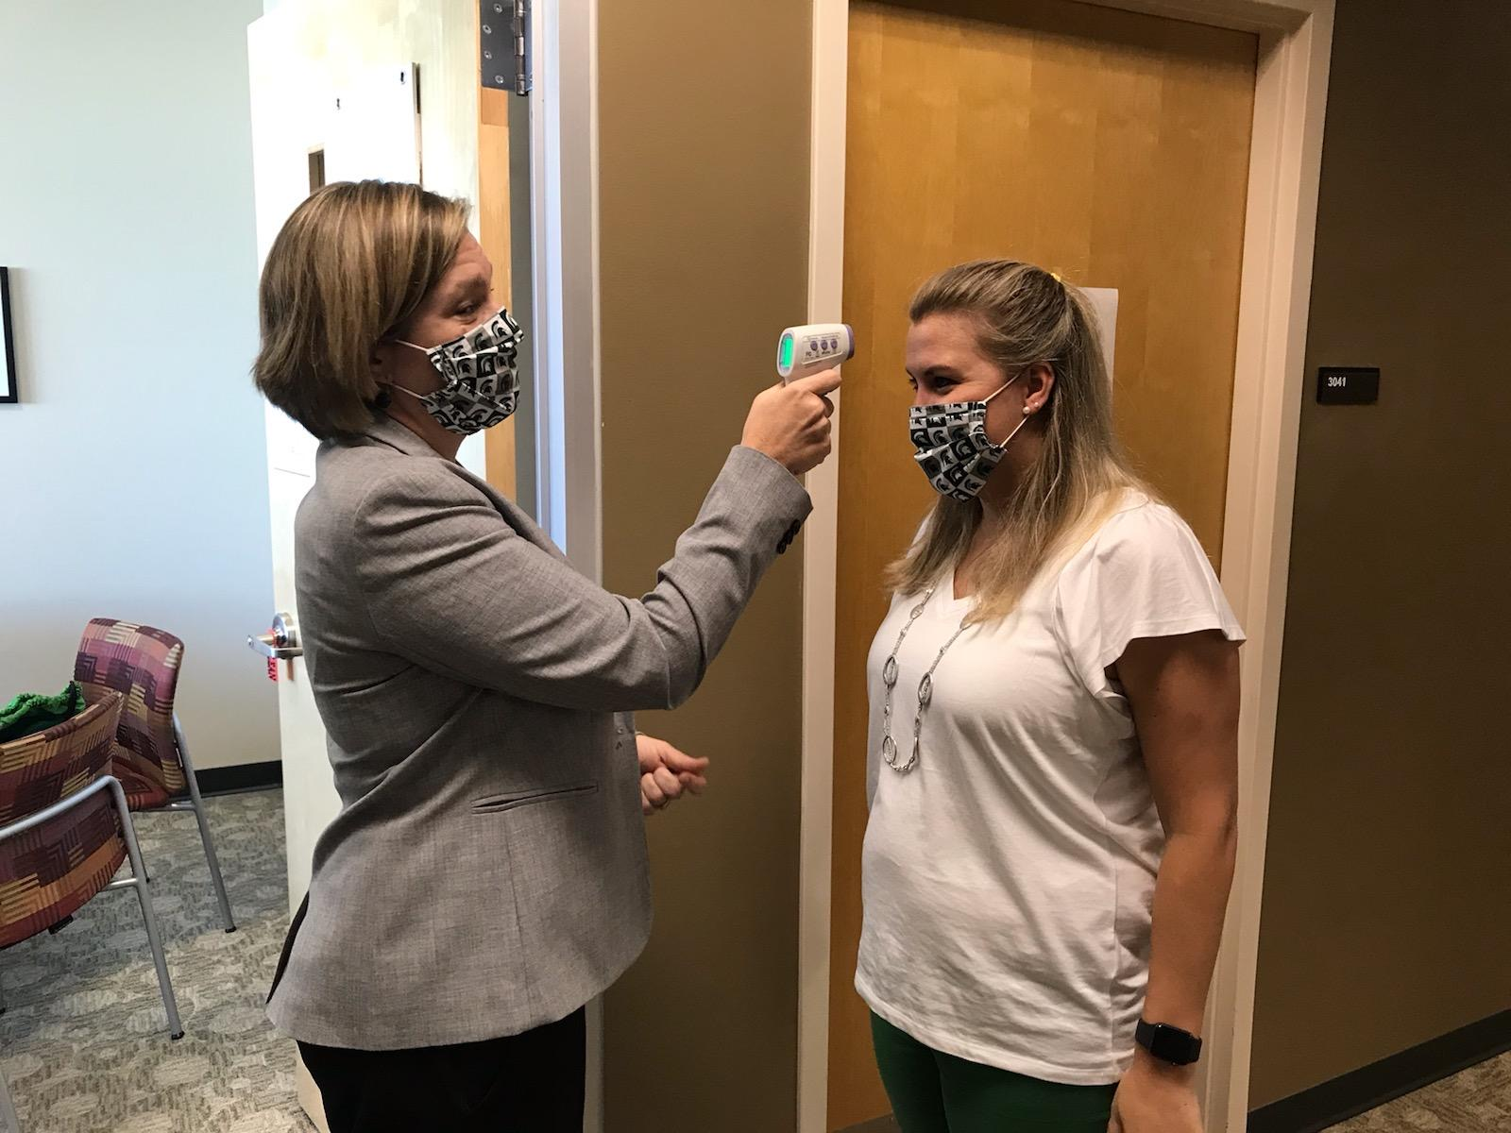
General Findings
In general, patients who are blind or visually impaired want:
medical professionals who are respectful, practice good communication, and assume competence on the part of the patient
information about their care and treatment plan
effective care

Slide 14
Healthcare Accessibility for People who are Blind or have Low Vision
Facility access
Facilities and medical equipment should be accessible to patients with disabilities
Examples of the facility features covered in the 2010 ADA Standards for Accessible Design include:
Paths of travel
Signage
Transportation facilities
Protruding objects
Elevators

Slide 15
Facility Access (cont.)
Provide accessible signage, maps, and wayfinding available to promote navigation for people who are blind or have low vision, whether they are the patient or a visitor.
Image is an example of what someone with 20/200 acuity might see.

Slide 16
Effective Communication
Effective communication with people with disabilities and their companions is important in every part of healthcare.
Healthcare providers are generally required to take the necessary steps to effectively communicate by providing auxiliary aids and services.
Exceptions to this rule are limited.
Public Entities are required to give primary consideration to the type requested
Goal: to find a practical solution that provides communication
Examples of auxiliary aids and services include:
Qualified readers
Braille or Large Print materials
Accessible electronic and information technology

Slide 17
Check-in and Registration
Forms and documents should be provided in the patient’s preferred format – braille, large print, read aloud, or electronic.
When materials are presented on a website or kiosk, that digital platform should be fully accessible.
Patients should not be expected to bring their own reader or assistant.
Protecting patient privacy
Patients may need a separate room when the forms are being read aloud.
Accessible formats and devices provide privacy to an individual by allowing them to fill out the forms independently.

Slide 18
From the Focus Groups
Expressed gratitude when a private room was provided to fill out forms with staff person
Some people were told they had to bring a person to help with forms
When staff assisted with forms, some people experienced longer wait times

Slide 19
Meal Delivery
Making order forms and menus accessible
Letting the patient know a meal has arrived
Answering questions about what has been served

Slide 20
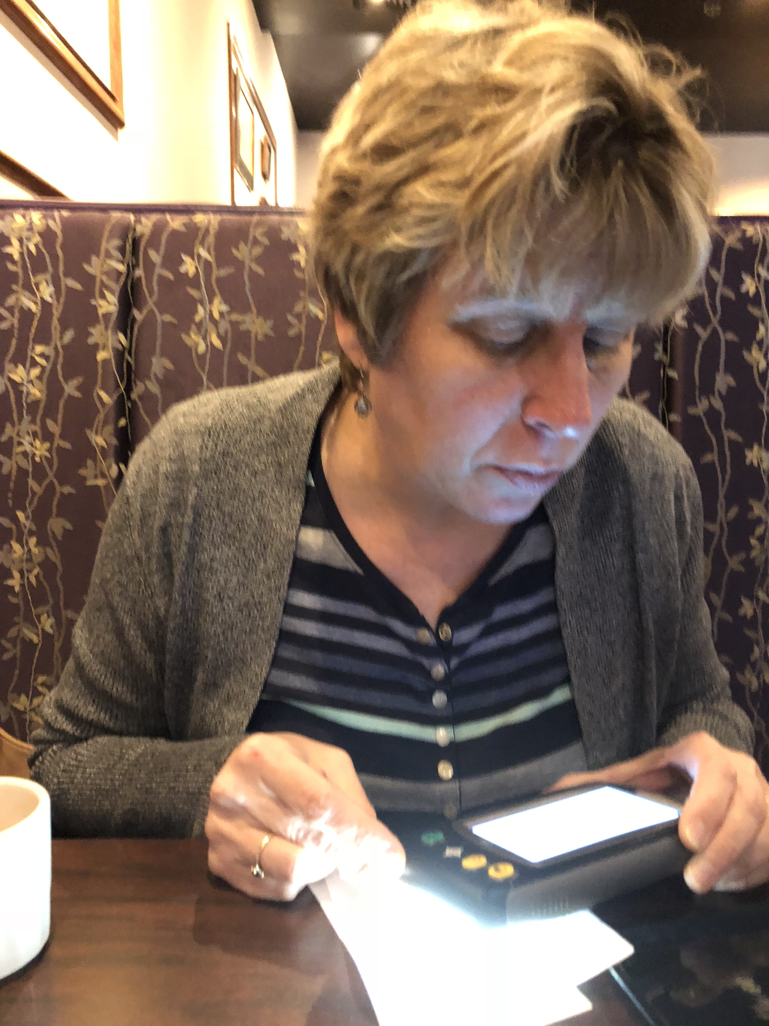
Post-visit Instructions
Provide discharge documents in the patients’ preferred format: e.g., large print, braille, or electronic
If documents are read aloud, ensure the patient is in an appropriate state to receive the information and ask follow-up questions.

Slide 21
Digital Accessibility
Services and information are increasingly found online and using digital tools, e.g.:
Electronic Health Records
Websites
Telehealth
Digital diagnostic and remote monitoring
Ensuring accessibility upfront reduces costs involved in remediating barriers:
Procurement
Testing
Customer Support

Slide 22
Prescriptions
Mis-identifying medication can have serious consequences for people who cannot read medication labels.
To access prescription labeling guidance from the Access Board: https://www.access-board.gov/rx.html

Slide 23
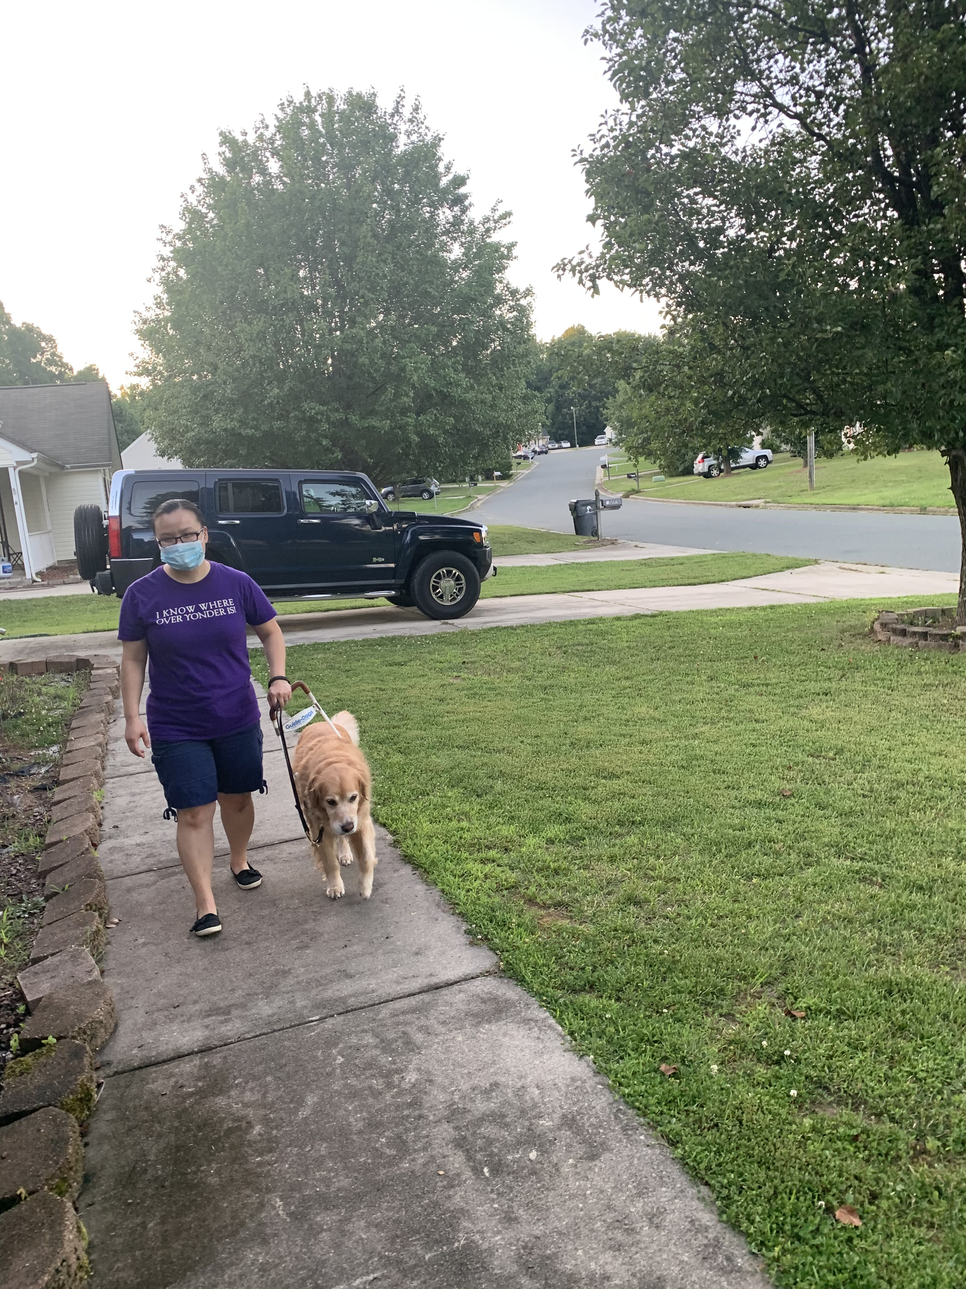
Service Animals
Service animals are allowed in:
Patient rooms
Anywhere that the public and patients are allowed to go
Ambulances
Department of Justice Q&A on Service Animals (https://www.ada.gov/regs2010/service_animal_qa.pdf)

Slide 24
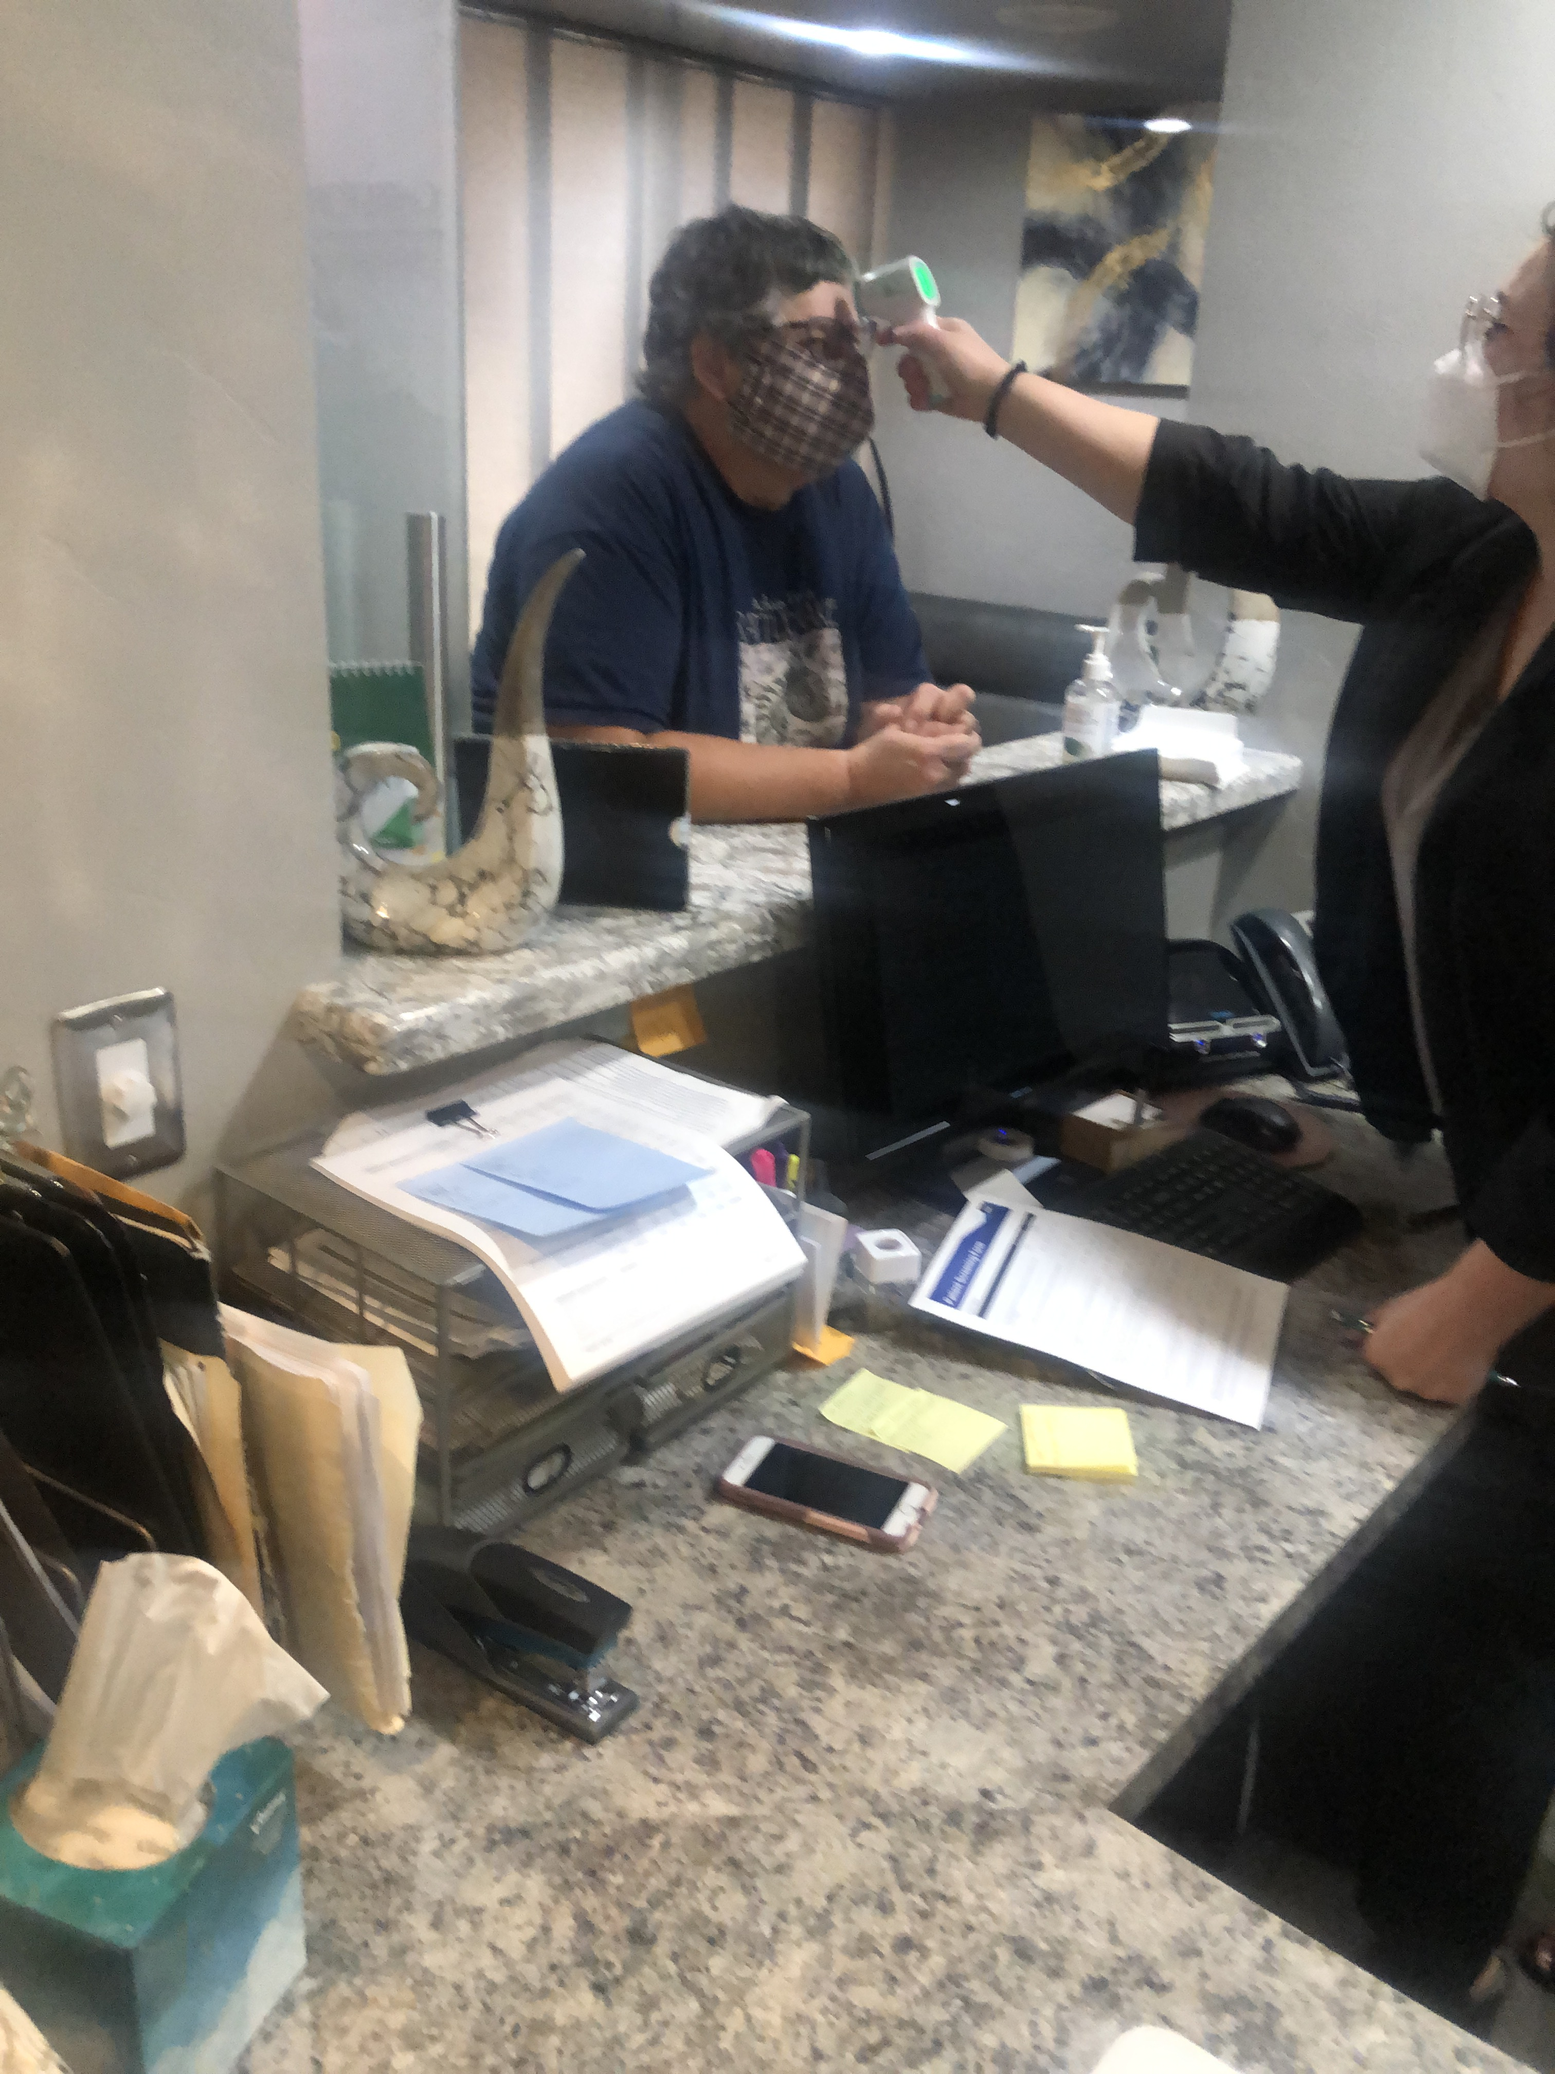
Disability Awareness Training
Announcing themselves and providing verbal instructions
Speaking directly to the patient unless otherwise indicated
Understanding blindness and low vision
Assisting with orientation
Opening communication to understand patient’s access needs

Slide 25
Healthcare Discrimination
The ADA and Section 1557 prohibit discrimination on the basis of disability. People who are blind or have low vision must not be denied cared or receive insufficient treatment based on their disability.

Slide 26
Our Resources
https://www.afb.org/blog/entry/resources-healthcare-workers
Handouts for healthcare professionals, registration staff, guest services, food, services, and support staff
Training Videos
Pre- and Post-Tests

Slide 27
Thank you
Dr. Arielle Silverman
asilverman@afb.org
Dr. Carlie Rhoads
crhoads@afb.org

